Slide 1


If you have been offered a super power then what will be your choice?
ⓘ Start presenting to display the poll results on this slide.
Notes:
📣 This is Slido interaction slide, please don't delete it. ✅ Click on 'Present with Slido' and the poll will launch automatically when you get to this slide.

Slide 2

What are the terms you have learned so far?
ⓘ Start presenting to display the poll results on this slide.
Notes:
📣 This is Slido interaction slide, please don't delete it. ✅ Click on 'Present with Slido' and the poll will launch automatically when you get to this slide.

Slide 3

Chapter C3 : Accounting Equation & Process
Lesson 9 : A = L + O/E
Lesson 10 : Owner’s Equity +C +I -E -D
Lesson 11 : Accounting Recording Process
Lesson 12 : Transaction Analysis
Lesson 13 : Tabular Analysis of Transaction (using equation)
& Double Entry System
Ejaj-Ur-Rahaman

Slide 4
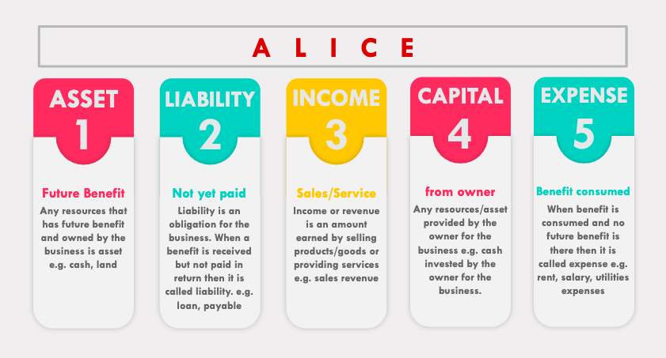
B2
Review
CHAPTER
Ejaj-Ur-Rahaman

Slide 5
5
Equation
Lesson
What is an Equation ?
a statement that the values of two mathematical expressions are equal (indicated by the sign =)
For example,
Left hand side = right hand side
20 = 20
Ejaj-Ur-Rahaman

Slide 6
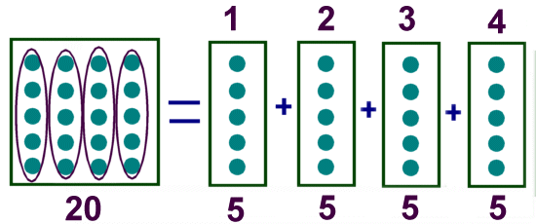
9
Equation
Lesson
examples
Ejaj-Ur-Rahaman

Slide 7
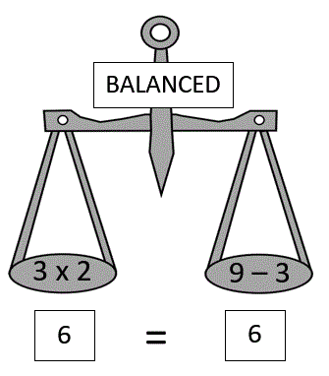
9
Equation
Lesson
examples
Ejaj-Ur-Rahaman

Slide 8
9
Equation
Lesson
What is an Accounting Equation ?
In accounting there is an equation and that is :
Assets = Liabilities + Owner’s Equity
5,000 = 2,000 + 3,000
00 = 00 + 00
3 = 0 + 3
Ejaj-Ur-Rahaman

Slide 9
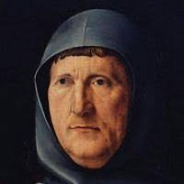
9
Equation
Lesson
The Italian mathematician Luca Pacioli formulated a basic accounting equation formula in 1494 in his work “A Treatise on Accounts and Records.” Accounting systems of all countries are based on the use of this basic accounting equation.
Ejaj-Ur-Rahaman

Slide 10
9
Double Entry System
Lesson
The double-entry system of accounting or bookkeeping means that for every business transaction, amounts must be recorded in a minimum of two accounts.
Mr. Umair started a his own business by investing Tk. 50,000
Assets = Liabilities + Owner’s Equity
+Cash = 0 + Capital
+50,000 = 0 + 50,000
Ejaj-Ur-Rahaman

Slide 11
Review
Assets
Liabilities
Owner’s Equity
=
+
Ejaj-Ur-Rahaman
Notes:
ThingLink
The founders of Google, Larry Page and Sergey Brin

Slide 12

Which of the following are not assets -
ⓘ Start presenting to display the poll results on this slide.
Notes:
📣 This is Slido interaction slide, please don't delete it. ✅ Click on 'Present with Slido' and the poll will launch automatically when you get to this slide.

Slide 13
Choose the correct answer
ⓘ Start presenting to display the poll results on this slide.
Notes:
📣 This is Slido interaction slide, please don't delete it. ✅ Click on 'Present with Slido' and the poll will launch automatically when you get to this slide.

Slide 14
Review
Assets
Cash
Accounts Receivable
Equipment
Building
Bank Account
Liabilities
Loan
Accounts Payable
Notes Payable
Owner’s Equity
Capital
Income
Expense
Drawings by owners
=
+
Ejaj-Ur-Rahaman
Notes:
ThingLink
The founders of Google, Larry Page and Sergey Brin

Slide 15
Fill in the blank: Asset (Cash 20,000 + Land 10,000) = Liability (______?_____) + Owner's Equity (7,250)
ⓘ Start presenting to display the poll results on this slide.
Notes:
📣 This is Slido interaction slide, please don't delete it. ✅ Click on 'Present with Slido' and the poll will launch automatically when you get to this slide.

Slide 16
9
Resources
Lesson
Additional information/resource on Equation
https://www.bookstime.com/what-is-the-accounting-equation
https://courses.lumenlearning.com/vccs-acc211-17sp/chapter/the-basic-accounting-equation/
https://www.youtube.com/watch?v=ktzqiYqncd0
Ejaj-Ur-Rahaman

Slide 17
Chapter C3 : Accounting Equation & Process
Lesson 9 : A = L + O/E
Lesson 10 : Owner’s Equity +C +I -E -D
Lesson 11 : Accounting Recording Process
Lesson 12 : Transaction Analysis
Lesson 13 : Tabular Analysis of Transaction (using equation)
& Double Entry System
Ejaj-Ur-Rahaman

